Slide 1
CSC 112: Computer Operating Systems Lecture XX I/O
Department of Computer Science,
Hofstra University

Slide 2
Outline
Overview
Principles of I/O hardware
Principles of I/O software
Disks
Notes:
Some parts of this chapter will be skipped.

Slide 3
The Requirements of I/O
So far in this course:
We have learned how to manage CPU, memory
What about I/O?
Without I/O, computers are useless (disembodied brains?)
But… thousands of devices, each slightly different
How can we standardize the interfaces to these devices?
Devices unreliable: media failures and transmission errors
How can we make them reliable???
Devices unpredictable and/or slow
How can we manage them if we don’t know what they will do or how they will perform?
Some operational parameters:
Byte/Block
Some devices provide single byte at a time (e.g. keyboard)
Others provide whole blocks (e.g. disks, networks, etc)
Sequential/Random
Some devices must be accessed sequentially (e.g. tape)
Others can be accessed randomly (e.g. disk, cd, etc.)
Polling/Interrupts
Some devices require continual monitoring
Others generate interrupts when they need service

Slide 4
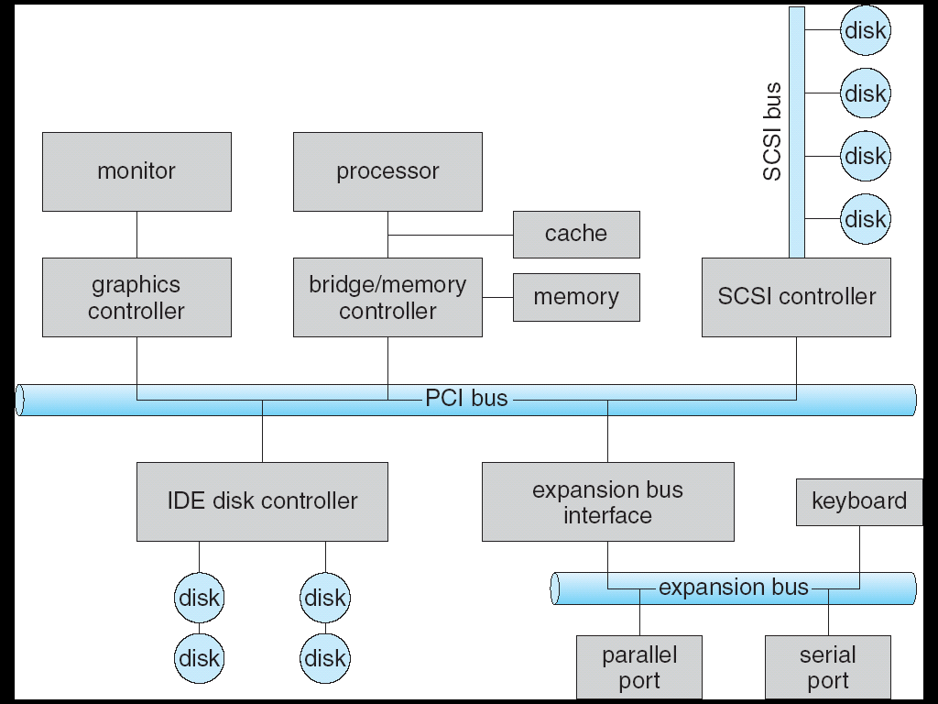

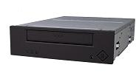
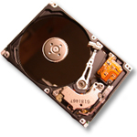

Modern I/O Systems

Slide 5
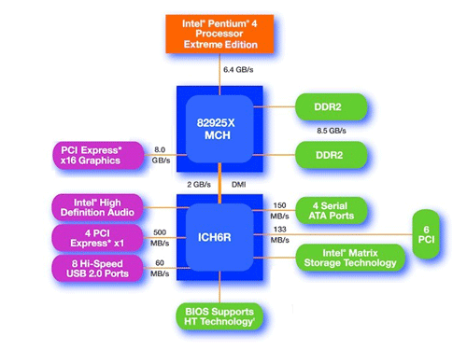
Main components of Intel Chipset: Pentium 4
Northbridge:
Handles memory
Graphics
Southbridge: I/O
PCI bus
Disk controllers
USB controllers
Audio
Serial I/O
Interrupt controller
Timers

Slide 6
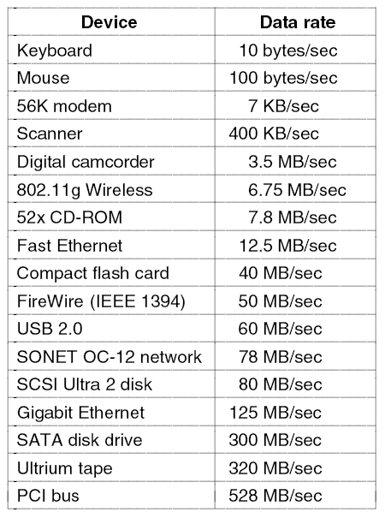
Device data-rates
Device data-rates vary over many orders of magnitude
System better be able to handle this wide range
Better not have high overhead/byte for fast devices!
Better not waste time waiting for slow devices

Slide 7
The Goal of the I/O Subsystem
Provide Uniform Interfaces, Despite Wide Range of Different Devices
This code works on many different devices:
int fd = open(“/dev/something”); for (int i = 0; i < 10; i++) { fprintf(fd,”Count %d\n”,i); } close(fd);
Why? Because code that controls devices (“device driver”) implements standard interface.
Notes:
We will try to get a flavor for what is involved in actually controlling devices in rest of lecture
Can only scratch surface!

Slide 8
Want Standard Interfaces to Devices
Block Devices: e.g. disk drives, tape drives, DVD-ROM
Access blocks of data
Commands include open(), read(), write(), seek()
Raw I/O or file-system access
Memory-mapped file access possible
Character Devices: e.g. keyboards, mice, serial ports, some USB devices
Single characters at a time
Commands include get(), put()
Libraries layered on top allow line editing
Network Devices: e.g. Ethernet, Wireless, Bluetooth
Different enough from block/character to have own interface
Unix and Windows include socket interface
Separates network protocol from network operation
Includes select() functionality
Usage: pipes, FIFOs, streams, queues, mailboxes

Slide 9
Outline
Overview
Principles of I/O hardware
Principles of I/O software
Disks
Notes:
Some parts of this chapter will be skipped.

Slide 10
Structure of I/O Units
A mechanical component: the device itself
Disk: platters, heads, motors, arm, etc.
Monitor: tube, screen, etc.
An electronic component: device controller, adaptor
Disk: issuing commands to mechanical components, assembling, checking and transferring data
Monitor: read characters to be displayed and generate electrical signals to modulate the CRT beam

Slide 11
Mechanical / Electronic Components
Mechanical components
Floppy disk
Hard disk
Monitor
Keyboard
Floppy disk controller
Video controller
Keyboard controller
Hard disk controller
CPU
Memory
Electronic components
Bus
Notes:
Components are connected by a system bus (simple version)
In practice, a machine may contain multiple buses.

Slide 12
How does the processor actually talk to the device?
Processor Memory Bus
Regular
Memory
CPU
Bus
Adaptor
Bus
Adaptor
Device
Controller
Address+
Data
Other Devices
or Buses
Bus
Interface
Hardware
Controller
Interrupt
Controller
Interrupt Request
read
Addressable
Memory
and/or
Queues
CPU interacts with a Controller
Contains a set of registers that can be read and written
write
control
status
Registers
(port 0x20)
Memory Mapped
Region: 0x8f008020
Notes:
May contain memory for request queues or bit-mapped images

Slide 13
Device controller
A device controller has registers that control operation
DMA has registers for read/write, I/O device address, block size, starting destination address, state
There may also be a data buffer as part of the controller.
Video controller memory stores pixels to be displayed on screen
The CPU must communicate with the controller to read or write these control registers and data buffers
Notes:
CPU interacts with a Controller
Contains a set of registers that can be read and written
May contain memory for request queues or bit-mapped images
Regardless of the complexity of the connections and buses, processor accesses registers in two ways:
I/O instructions: in/out instructions
Example from the Intel architecture: out 0x21,AL
Memory mapped I/O: load/store instructions
Registers/memory appear in physical address space
I/O accomplished with load and store instructions

Slide 14
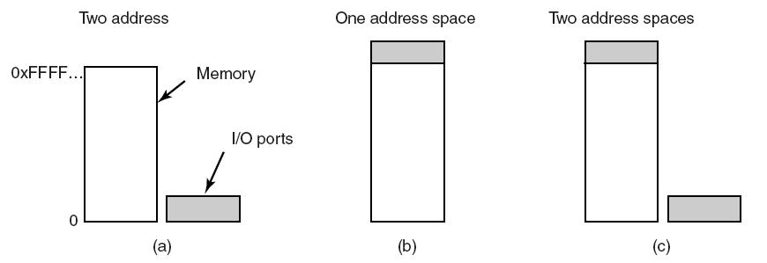
Memory and I/O space
(a) Separate I/O and memory space.
(b) Memory-mapped I/O: map device memory (data buffers and control registers) into CPU memory; each device memory address is assigned a unique CPU memory address
(c) Hybrid: data buffers are memory-mapped; control registers have separate memory space (I/O ports)
Notes:
Hybrid systems use memory mapping for I/0 data buffers and ports for data registers (Pentium)

Slide 15
Direct I/O
Each control register is assigned a port number PORT
Use special assembler language I/O instructions
IN REG, PORT: reads in control register PORT and stores result in CPU register REG
OUT PORT, REG: writes content of REG to control register PORT
Notes:
Transfer of one value to one controller register is one assembler language instruction

Slide 16
Memory-mapped I/O
Map all I/O control registers into the memory space
Memory map will have a block of addresses that physically corresponds the registers on the I/O controllers rather than to locations in main memory
When you read from/write to mem region for I/O control registers, the request does not go to memory; it is transparently sent to the I/O device
OS
Memory region for
I/O control registers
Process N
Process M
Memory map

Slide 17
Example: Memory-Mapped Display Controller
Memory-Mapped:
Hardware maps control registers and display memory into physical address space
Addresses set by hardware jumpers or programming at boot time
Simply writing to display memory (also called the “frame buffer”) changes image on screen
Addr: 0x8000F000—0x8000FFFF
Writing graphics description to command-queue area
Say enter a set of triangles that describe some scene
Addr: 0x80010000—0x8001FFFF
Writing to the command register may cause on-board graphics hardware to do something
Say render the above scene
Addr: 0x0007F004
Can protect with page tables
0x80020000
Graphics
Command
Queue
0x80010000
Display
Memory
0x8000F000
0x0007F004
Command
0x0007F000
Status
Physical Address
Space

Slide 18
Advantages: memory mapped I/O
Allows device drivers and low level control software to be written in C rather than assembler
Every instruction that can access memory can also access controller registers, reducing the number of instructions needed for I/O
Can use virtual memory mechanism to protect I/O from user processes
Memory region for I/O control registers are mapped to kernel space
Notes:
Can structure the system so that only needed drivers are loaded into user program (page per driver) Normal instructions to access memory can be used to directly access control registers

Slide 19
Disadvantages: memory mapped I/O
Need additional complexity in the OS
Cannot cache controller registers
Changes made in cache do not affect the controller!
Must assure that the memory range reserved for memory mapped control registers cannot be cached. (disable caching)
All memory modules and I/O devices must examine all memory references

Slide 20
Single Bus: memory mapping
CPU sends requested address along bus
Bus carries one request/reply at a time
Each I/O device controller checks if requested address is in thier memory space
Device controller whose address space does contain the address replies with the requested value from that address
CPU
memory
I/O
I/O

Slide 21
Memory Bus: memory mapping
Most CPUs have a high-speed bus for memory access, and a low-speed bus for peripheral I/O device access.
CPU first sends memory request to the memory bus, and if that fails (address not found in memory), send it to the I/O bus.
CPU
memory
I/O
I/O
HS Bus
Low-Speed Bus
Notes:
Optimized architectures with other bus structures may require special support for memory mapping
Memory accesses meant for mapped I/O registers will go to main memory along the high speed memory bus!
Use a dedicated filter (chip) to determine which bus to send to
Send to memory first, then bus if not found

Slide 22
Direct Memory Access (DMA)
Request data from I/O without DMA
Device controller reads data from device
It interrupts CPU when a byte/block of data available
CPU reads controller’s buffer into main memory
Too many interruptions, expensive
DMA: direct memory access
A DMA controller with registers read/written by CPU
CPU programs the DMA: what to transfer where
Source, destination and size
DMA interrupts CPU only after all the data are transferred.

Slide 23
Operations of DMA
DMA controller
Disk controller
Main memory
Drive
1. CPU programs the DMA and controller
Buffer
CPU
Address
Count
4. Ack
Control
Interrupt when done
2. DMA requires transfer to memory
3. Data transferred
Bus
Notes:
DMA steps.
CPU programs DMA controller by setting registers
Address, count, control
DMA controller initiates the transfer by issuing a read request over the bus to the disk controller
Write to memory in another standard bus cycle
When the write is done, disk controller sends an acknowledgement signal to DMA controller
If there is more to transfer, go to step 2 and loop
DMA controller interrupts CPU when transfer is complete.
CPU doesn’t need to copy anything.

Slide 24
DMA Details
CPU programs DMA controller by setting registers
Address, count, control
DMA controller initiates the transfer by issuing a read request over the bus to the disk controller
Write to memory in another standard bus cycle
When the write is done, disk controller sends an acknowledgement signal to DMA controller
If there is more to transfer, go to step 2 and loop
DMA controller interrupts CPU when transfer is complete.
CPU doesn’t need to copy anything.

Slide 25
Transfer Modes
Word-at-a-time (cycle stealing)
DMA controller acquires the bus, transfer one word, and releases the bus
CPU waits for bus if data is transferring
Cycle stealing: steal an occasional bus cycle from CPU once in a while
Burst mode
DMA holds the bus until a series of transfers complete
More efficient since acquiring bus takes time
Block the CPU from using bus for a substantial amount of time

Slide 26
Outline
Overview
Principles of I/O hardware
Principles of I/O software
Disks
Notes:
Some parts of this chapter will be skipped.

Slide 27
Types of I/O
Synchronous I/O
Programmed I/O:
Process busy-waits (polls) while I/O is completed
Asynchronous I/O
Interrupt driven I/O:
CPU issues an I/O command to I/O device
CPU enters wait state
CPU continues with other processing (same or more likely different process)
I/O device generates an interrupt when it finishes and the CPU finishes processing the interrupt before continuing with its present calculations.
Direct Memory Access (DMA)
Notes:
The simplest approach: Programmed I/O
CPU issues an I/O command
CPU busy waits (or polls) while I/O is completed
Interrupt Driven
CPU issues an I/O command to I/O device
CPU enters wait state
CPU continues with other processing (same or more likely different process)
I/O device generates an interrupt when it finishes and the CPU finishes processing the interrupt before continuing with its present calculations.
DMA (also interrupt driven) block transfer

Slide 28
Interrupts
Interrupt controller
1. Device finishes a work
3. CPU acks interrupt
Disk
Keyboard
CPU
Clock
2. Controller issues interrupt
Printer
Bus
Notes:
Interrupts are inevitable.

Slide 29
Interrupt Processing
I/O devices raise interrupt by asserting a signal on a bus line assigned
Multiple interrupts → the one with high priority goes first
Interrupt controller interrupts CPU
Put device # on address lines
Device # → check interrupt vector table for interrupt handler (a program)
Enable interrupts shortly after the handler starts

Slide 30
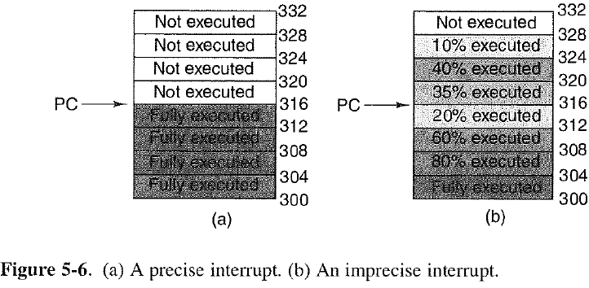
Precise interrupts
Properties of a precise interrupt
PC (Program Counter) is saved in a known place.
All instructions before the one pointed to by the PC have fully executed.
No instruction beyond the one pointed to by the PC has been executed.
Execution state of the instruction pointed to by the PC is known.
Notes:
Precise interrupt: leaves the machine in a well defined state that can easily be returned to
The program counter is saved (the execution state of the instruction pointed to by the program counter is know)
All instructions prior to the one pointed to by the program counter have executed completely
No instruction after the one pointed to by the program counter has been executed

Slide 31
Pipelining: a complication
We have said: the interrupt can be processed after the presently executing machine language instruction is completed. This is a simplification
In many modern machines pipelining is used to more efficiently execute instructions. This means several instructions may be executing simultaneously. Need to be sure this is taken into account

Slide 32
Pipelining
In a pipelined processor, multiple instructions may be in the pipeline at the same time
To make a pipelined processor’s interrupt precise
Flush pipeline (complete all stages of all instructions in the pipeline) before executing the interrupt
Load 1
Load 2
Load 3
Load 4
Load 5
Load 6
Decode 1
Decode 2
Decode 3
Decode 4
Decode 5
Access 1
Access 2
Access 3
Access 4
Execute 1
Execute 2
Execute 3
interrupt
Notes:
Program counter gives next instruction to be loaded
Flush pipeline before processing interrupt (produce a precise interrupt)
Careful programming to protect interrupt, refill pipeline to pre interrupt state (produce an imprecise interrupt)

Slide 33
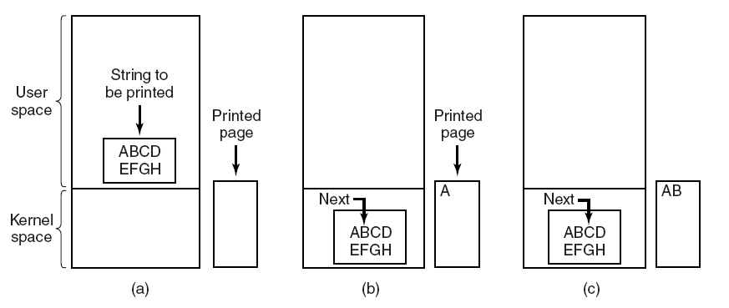
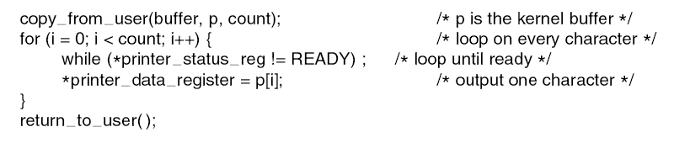
Programmed I/O: Writing a String to Printer
33

Slide 34
Programmed I/O
First the data are copied to the kernel. Then the operating system enters a tight loop outputting the characters one at a time.
After outputting a character, the CPU continuously polls the device in a while loop to see if it is ready to accept another one.
Busy waiting wastes CPU time while waiting for IO to complete

Slide 35
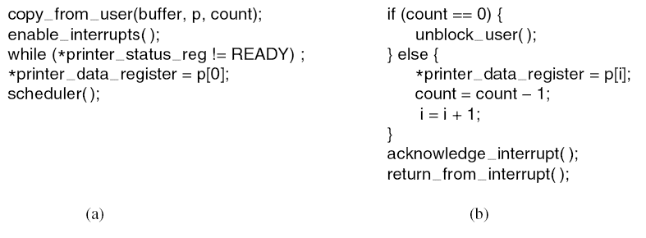
Interrupt-Driven I/O
(a) Code executed at the time the print system call is made. Buffer is copied to kernel space; 1st char is copied to printer as soon as it is ready to accept a char
(b) ISR for printer interrupt. When printer has printed the 1st char, it generates an interrupt to run the ISR; if no more chars to print, it unblocks the user process; otherwise, it prints the next char and returns from the interrupt. Each interrupt grabs one char from the kernel buffer and prints it.

Slide 36
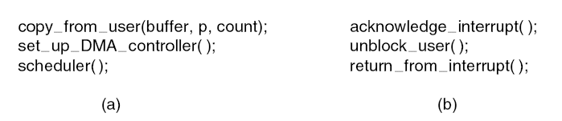
I/O using DMA
(a) Code executed when the print system call is made.
(b) ISR for printer interrupt
Let the DMA controller feed the chars to printer one at a time to free up the CPU

Slide 37
I/O Software Layers
 | User-level I/O software
 | Device-independent I/O software
 | Device drivers
 | Interrupt handlers
Hardware
Notes:
Each layer has
A well defined function to perform
A well-defined interface to the adjacent layers
It is a general model.

Slide 38
Interrupt Handlers
Hide I/O interrupts deep in OS
Device driver starts I/O and blocks (e.g., down a mutex)
Interrupt wakes up driver
Process an interrupt
Save registers ( which to where?)
Set up context (TLB, MMU, page table)
Run the handler (usually the handler will be blocked)
Choose a process to run next
Load the context for the newly selected process
Run the process
Notes:
Interrupts are used for most I/O
The steps of interrupt has been studied before. For details, please refer to page 288-289.

Slide 39
Device Drivers
Device-specific code for controlling I/O devices
Written by manufacture, delivered along with device
One driver for one (class) device(s)
Position: part of OS kernel, below the rest of OS
Interfaces for rest of OS
Block device and character device have different interfaces
Notes:
Each controller has some device registers for accepting commands, storing status.
Number of registers and the nature of the commands vary radically from device to device.

Slide 40
Logical Position of Device Drivers
User program
User space
Rest of the OS
Kernel space
Printer driver
Hardware
Printer controller
Devices
printer

Slide 41
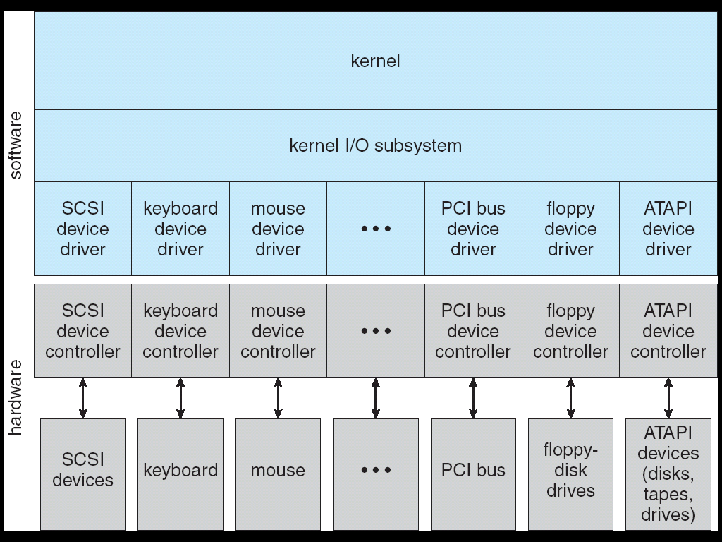
Kernel I/O Structure

Slide 42
How to Install a Driver?
Re-compile and re-link the kernel
Drivers and OS are in a single binary program
Used when devices rarely change
Dynamically loaded during OS initialization
Used when devices often change
Dynamically loaded during operation
Plug-and-Play
Notes:
Difficult to obtain source code
Users don’t know how to compile OS

Slide 43
Functions of Device Drivers
Accept abstract read/write requests
Error checking, parameter converting
Check status, initialize device, if necessary
Issue a sequence of commands
May block and wait for interrupt
Check error, return data
Other issues: re-entrant, up-call, etc.

Slide 44
Device-Independent I/O Software
Why device-independent I/O software?
Perform I/O functions common to all devices
Provide a uniform interface to user-level software
It provides:
Uniform interfacing for devices drivers
Buffering
Error reporting
Allocating and releasing dedicated devices
Providing a device-independent block size
 | User-level I/O software
 | Device-independent I/O software
 | Device drivers
 | Interrupt handlers
Hardware

Slide 45
Uniform Interfacing for Device Drivers
New device → modify OS, not good
Provide the same interface for all drivers
Easy to plug a new driver
In reality, not absolutely identical, but most functions are common
Name I/O devices in a uniform way
Mapping symbolic device names onto the proper driver
Treat device name as file name in UNIX
E.g., hard disk /dev/disk0 is a special file. Its i-node contains the major device number, which is used to locate the appropriate driver, and minor device number.

Slide 46
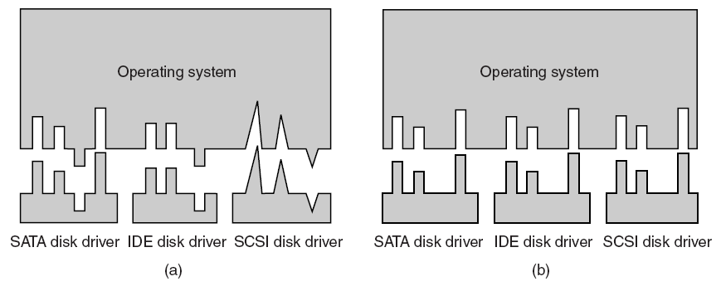
Uniform Interfacing for Device Drivers
Figure 5-14. (a) Without a standard driver interface. (b) With a standard driver interface.

Slide 47
Buffering for Input
Motivation: consider a process that wants to read data from a modem
User process handles one character at a time.
It blocks if a character is not available
Each arriving character causes an interrupt
User process is unblocked and reads the character.
Try to read another character and block again.
Many short runs in a process: inefficient!
Overhead of context switching

Slide 48
Buffering in User Space
Set a buffer in user process’ space
User process is waked up only if the buffer is filled up by interrupt service procedure. More efficient.
Can the buffer be paged out to disk?
If yes, where to put the next character?
No, by locking page in memory: the pool of other (available) pages shrink
User space
Kernel space
Buffering in user space

Slide 49
Buffering in Kernel
Two buffers: one in kernel and one in user
Interrupt handler puts characters into the buffer in kernel space
Kernel buffers are never paged to disk
When full, copy the kernel buffer to user buffer
But where to store the new arrived characters when the user-space page is being loaded from disk?
Buffering in kernel
User space
Kernel space
Notes:
Bring in the user buffer if necessary

Slide 50
Double Buffering in Kernel
Two kernel buffers
When the first one fills up, but before it has been emptied, the second one is used.
Buffers are used in turn: while one is being copied to user space, the other is accumulating new input
User space
Kernel space
Double buffering

Slide 51
Downside of Data Buffering
Many sequential buffering steps slow down transmission
User space
Process A
Process B
1
5
Kernel space
2
4
Network controller
3
Network

Slide 52
Handling I/O Errors
Programming errors: ask for something impossible
E.g. writing a keyboard, reading a printer
Invalid parameters, like buffer address
Report an error code to caller
Actual I/O error
E.g. write a damaged disk block
Handled by device driver and/or device-independent software
System error
E.g. root directory or free block list is destroyed
display message, terminate system
Notes:
Many errors are device-specific and handled by the appropriate driver. But the framework for error handling is device independent.

Slide 53
Allocating Dedicated Devices
Before using a device, make the system call open
When the device is unavailable
The call fails, or
The caller is blocked and put on a queue
Release the device by making the close system call

Slide 54
Summary: I/O Software
I/O request
I/O reply
 | User-level I/O software |  | Make I/O call; format I/O; spooling
 | Device-independent OS software |  | Naming, protection, blocking, buffering, allocation
 | Device drivers |  | Setup device registers; check status
 | Interrupt handlers |  | Wake up driver when I/O completed
Hardware |  |  | Perform I/O operation

Slide 55
Outline
Overview
Principles of I/O hardware
Principles of I/O software
Disks
Notes:
Some parts of this chapter will be skipped.

Slide 56
Types of Disks
Magnetic disks
Hard disks and floppy disks
Reads/writes are equally fast
Ideal secondary memory
Highly reliable storage
Optical disks
CD-ROM, CD-R: 600MB
DVD: 4.7-17GB
Flash disks
USB drive
Notes:
Details of optical disks can be found in pages 306-315, textbook.

Slide 57
Disk Geometry
Sector
Disk Arm
track
Platter
Platter
Platter
Each surface on the platter are divided into tracks and each track is further divided into sectors. A sector is the smallest unit that can be read or written. A cylinder consists of multiple tracks at the same position on different platters.

Slide 58
Properties
Independently addressable element: sector
A block is a group of sectors. OS always transfers multiple blocks.
A disk can access directly any given block of information it contains (random access). Can access any file either sequentially or randomly.
A disk can be rewritten in place: it is possible to read/modify/write a block from the disk
Typical numbers (depending on the disk size):
500 to more than 20,000 tracks per surface
32 to 800 sectors per track
Notes:
Here is a primitive picture showing you how a disk drive can have multiple platters.
Each surface on the platter are divided into tracks and each track is further divided into sectors. A sector is the smallest unit that can be read or written.
By simple geometry you know the outer track have more area and you would thing the outer tack will have more sectors.
This, however, is not the case in traditional disk design where all tracks have the same number of sectors. Well, you will say, this is dumb but dumb is the reason they do it .
By keeping the number of sectors the same, the disk controller hardware and software can be dumb and does not have to know which track has how many sectors.
With more intelligent disk controller hardware and software, it is getting more popular to record more sectors on the outer tracks. This is referred to as constant bit density. Zoned bit recording
Constant bit density: more sectors on outer tracks
Speed varies with track location
+2 = 32 min. (Y:12)

Slide 59
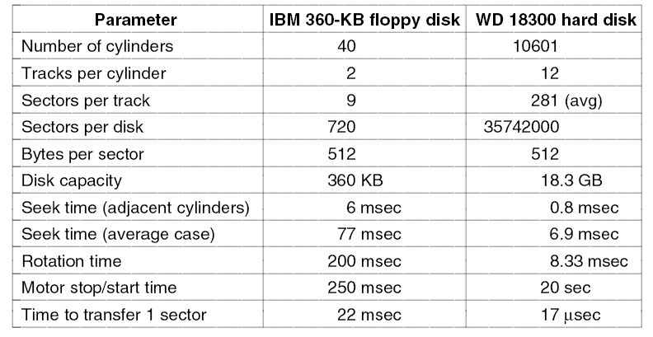
Comparison of old and new disks
Figure 5-18. Disk parameters for the original IBM PC 360-KB floppy disk and a Western Digital WD 18300 hard disk.

Slide 60
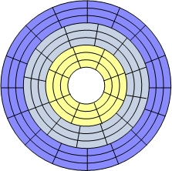
Zones
Real disks will have zones with more sectors towards the outer edge and fewer toward the inner edge
Most disks present a virtual geometry to the OS, which assumes a constant number of sectors per track. The controller maps the OS requested sector to the physical sector on the disk
zone

Slide 61
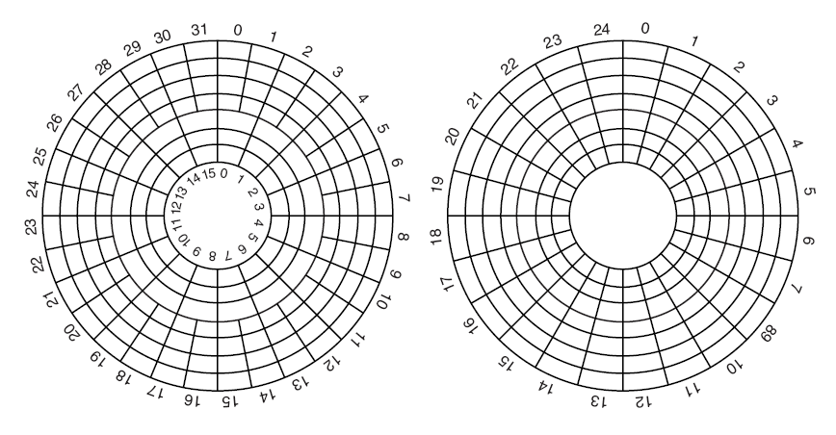
Physical vs. Virtual Geomery
Figure 5-19. (a) Physical geometry of a disk with two zones. (b) A possible virtual geometry for this disk.

Slide 62
Cylinders
In the disk there are multiple platters (often two sided). And there are heads to read each side of each platter
All the heads move in and out together.
If we consider one head it is above a particular track on a particular platter of the disk
If we consider the whole disk, A cylinder is the group of tracks (track n on each side of each platter) that can be read when the heads are in a particular position (above a certain track)

Slide 63
Sectors
Each sector contains
Preamble: synchronization marker
Sector information, cylinder and sector number
Data
Error detection/correction information
Whole sector is read to buffer in controller
Error detection/correction is performed
Data is transferred to its destination memory address from the disk controller’s buffer

Slide 64
Format of a Sector
Preamble | Data | ECC
Gap
A disk sector
Preamble: recognize the start of the sector. It also contains the cylinder and sector numbers.
Data: most disks use 512-byte sectors
ECC (Error Correcting Code): can be used to recover from errors
Gap between sectors

Slide 65
Cost of Read / Write A Disk Block
Seek time
Time to move the arm to the proper cylinder
Dominate the other two times for most disks
E.g., 0.8 msec for adjacent cylinders
Rotational delay
Time for the proper sector to rotate under the head
E.g, 0.03 msec for adjacent sectors
Data transfer time
E.g., 17 μsec for one sector
Notes:
Platters spin at some rate (7200rpm is a typical fast disk)
Read/write head must move to the correct track (seek time)
Read/write head must wait for the correct sector (rotational latency, rotational delay)
Actual read/write of data must occur (access time)
Data must be transferred to/from the disk controller (transfer time)

Slide 66
Cylinder Skew
The position of sector 0 on each track is offset from the previous track. This offset is called cylinder skew.
Allow the disk to read multiple tracks in one continuous operation without losing data
Direction of disk rotation
Direction of disk rotation
0
3
0
0
3
3
2
3
1
0
1
1
2
2
2
No skew
1
1-sector skew

Slide 67
Sector Interleaving
Consider a controller with one sector buffer. A request of reading two consecutive sectors. When the controller is busy with transferring one sector of data to memory, the next sector will fly by the head.
Solution: sector interleaving
7
0
7
0
5
0
6
3
2
1
4
3
5
6
7
2
1
6
4
3
2
5
4
1
No interleaving
Single interleaving
Double interleaving

Slide 68
Disk Scheduling
Want to schedule disk requests to optimize performance. Must consider
Seek time (time to move the arm to the proper cylinder)
Rotational delay (time for the proper sector to rotate under the head)
Data transfer time
Different approaches to the order in which disk accesses are processed
Notes:
Read/write time factors
Seek time (the time to move the arm to the proper cylinder).
Rotational delay (the time for the proper sector to rotate under the head).
Actual data transfer time.
Simply taking a random request from the I/O queue is the benchmark and will be referred to aa random scheduling.

Slide 69
First Come First Serve
Requests are removed from the queue in the order that they arrived.
For a small number of processes, each process will have clusters of nearby accesses so some improvement over random scheduling may occur
For a large number of processes, many areas on the disk may be in demand. May perform very similarly to random request order

Slide 70
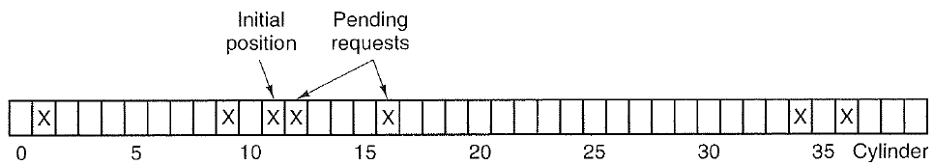
FCFS Example
Consider a disk with 40 cylinders. Requests for cylinder # 11, 1, 36, 16, 34, 9, 12 come in that order
From initial position of 11, the disk arm serves requests in the order of (1, 36, 16, 34, 9, 12) with movements of (10, 35, 20, 18, 25, 3), total of 111 cylinders

Slide 71
Shortest seek first (SSF)
Choose the request in the queue whose location on the disk is closest to the present location of the head (shortest seek time)
More efficient than FCFS, transfer time cannot be changed so minimizing seek time will help optimize the system
Can cause starvation, If there are many requests in one area of the disk, processes using other parts of the disk may never have their requests filled.
On a busy system the arm will tend to stay near the center of the disk
Need a tie breaking algorithm (what if there are two requests the same distance away in different directions)

Slide 72
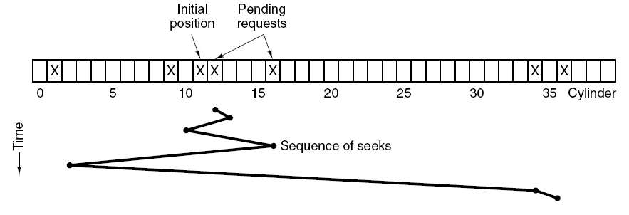
SSF Example
From initial position of 11, the disk arm serves requests in the order of (12, 9, 16, 1, 34, 36) with movements of (1, 3, 7, 15, 33, 2), total of 61 cylinders

Slide 73
Problem with SSF
Suppose more requests keep coming in while the requests are being processed.
For example, if, after going to cylinder 16, a new request for cylinder 8 is present, that request will have priority over cylinder 1. If a request for cylinder 13 then comes in, the arm will next go to 13, instead of 1.
With a heavily loaded disk, the arm will tend to stay in the middle of the disk most of the time, so requests at either extreme will have to wait a long time
Requests far from the middle may get poor service.

Slide 74
Elevator Algorithm (SCAN)
Keep moving in the same direction until there are no more outstanding requests in that direction, then switch directions.
Notes:
Choose the closest request in a particular direction
Take successive requests moving towards the centre of the disk
When you reach the centremost request then take successive requests moving toward the edge.
Has the advantage that all requests will be serviced

Slide 75
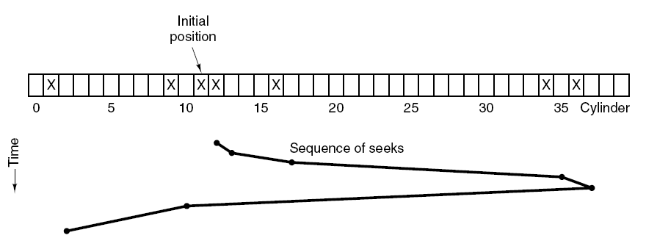
SCAN Algorithm Example
From initial position of 11, the disk arm serves requests in the order of (12, 16, 34, 36, 9, 1) with movements of (1, 4, 18, 2, 27, 8), total of 61 cylinders

Slide 76
Circular SCAN
A variant of SCAN
Always scan in the same direction. When the highest numbered cylinder with a pending request has been serviced, the arm goes to the lowest-numbered cylinder with a pending request and then continues moving in an upward direction.
Q: What is the upper bound of disk arm movement distance for serving one request for SCAN? For C-SCAN?
A: both twice the number of total cylinders

Slide 77
Quiz
Initial position
Request order
 | 1 |  |  |  |  | 5 |  | 0 | 7 |  |  |  | 2 |  |  | 3 |  | 6 | 4
Cylinder Number
1
6
8
9
13
16
18
19
What is the sequence of servicing requests for FCFS, SSF, SCAN and C-SCAN?
FCFS: cylinder 8→1→13→16→19→6→18→9, total 59 cylinders
SSF: cylinder 8→9→6→1→13→16→18→19, total 27 cylinders
SCAN: cylinder 8→9→13→16→18→19→6→1, total 29 cylinders
Assume the direction is initially UP.
C-SCAN: cylinder 8→9→13→16→18→19→1→6, total 34 cylinders
Assume the direction is initially UP.

Slide 78
Exercise
Workout the sequence of servicing requests for FCFS, SSF and SCAN for the following order of requests (initial position of disk head is 53):
98, 183, 37, 122, 14, 124, 65, 67
Answer:
FCFS: http://cs.uttyler.edu/Faculty/Rainwater/COSC3355/Animations/diskschedulingfcfs.htm
SSF: http://cs.uttyler.edu/Faculty/Rainwater/COSC3355/Animations/diskschedulingsstf.htm
SCAN:
http://cs.uttyler.edu/Faculty/Rainwater/COSC3355/Animations/diskschedulingscan.htm

Slide 79
RAID
Redundant Array of Inexpensive Disks
A set of physical disk drives seen as a single logical drive by the system (OS)
Data (individual files) are distributed across multiple physical drives
Access can be faster, access multiple disks to get the data
Controller controls mapping and setup of RAID structure on the group of disks
OS sees the equivalent of a single disk
Different levels of optimization, different approaches

Slide 80
RAID Level 0
Individual disk controllers are replaced by a single RAID 0 controller than simultaneously manages all disks. It is capable of simultaneously transferring from all the disks
Each disk is divided into stripes. A stripe may be a block, a sector, or some other unit.
When a large write to disk is requested the RAID 0 controller will break the requested data into strips. The first strip will be placed on the first disk, the second on the second disk and so on in a round robin fashion.
Stripes indicated by colours
Stripe 0
Stripe 1
Stripe 2
Stripe 3
Stripe 4
Stripe 5
Stripe 6
Stripe 7
Stripe 8
Stripe 9
Stripe 10
Stripe 11
Stripe 12
Stripe 13
Stripe 14
Stripe 15

Slide 81
RAID Level 0
Dividing the data between N disks allows the RAID 0 controller to read/write the data N time faster
If two requests are pending there is a good chance they are on different disks and can be serviced simultaneously. This reduces the average time in the I/O queue
Works best for large read/write requests
Decreases mean time to failure over single large disk
Also called striping, no redundancy (so not true RAID)
Notes:
Systems with OSs that read one sector at a time will not see significant improvements using RAID 0

Slide 82

RAID Level 1
All data is duplicated, each logical strip is mapped to two different disks (same data stored in the two strips).
Each disk has a mirror disk that contains the same data copy.
To recover from failure on one disk read the data from the mirror disk
Stripe 0
Stripe 1
Stripe 2
Stripe 3
Stripe 0
Stripe 1
Stripe 2
Stripe 3
Stripe 4
Stripe 5
Stripe 6
Stripe 7
Stripe 4
Stripe 5
Stripe 6
Stripe 7
Stripe 8
Stripe 9
Stripe 10
Stripe 11
Stripe 8
Stripe 9
Stripe 10
Stripe 11
Stripe 12
Stripe 13
Stripe 14
Stripe 15
Stripe 12
Stripe 13
Stripe 14
Stripe 15
Notes:
(in fact RAID 1 can be applied to unstriped disks)

Slide 83
RAID Level 1
Each disk has a mirror disk that contains the same data.
A read request can be serviced by either disk containing the data (choose faster of the two available reads)
A write request requires both disks containing the data to be updated. (limited by slower or two writes)
Expensive, requires double the storage capacity
Useful, providing real time backup
If the bulk of I/O requests are reads can approach double the access speed of RAID0
(Details omitted for RAID2-6)
Notes:
If many of the I/O requests are reads may not see a significant access speed improvement On a read, either data copy can be used, so read performance can be twice as good.

Slide 84
Summary
Hardware Principle
Device controller: between devices and OS
Memory mapped I/O Vs. I/O port number
DMA vs. Interrupt
Software Principle
Programmed I/O: waste CPU time
Interrupts: overheads
DMA: offload I/O from CPU

Slide 85
Summary (Cont.)
Four layers of I/O software
Interrupt handlers: context switch, wake up driver when I/O completed
Device drivers: set up device registers, issue commands, check status and errors
Device-independent software: naming, protection, buffering, allocating
User-space software: make I/O call, format I/O, spooling

Slide 86
Summary (Cont.)
Disks
Structure: cylinder → track → sector
Disk scheduling algorithms: FIFO, SSTF, SCAN, C-SCAN
Notes:
I/O Devices Types:
Many different speeds (0.1 bytes/sec to GBytes/sec)
Different Access Patterns:
Block Devices, Character Devices, Network Devices
Different Access Timing:
Blocking, Non-blocking, Asynchronous
I/O Controllers: Hardware that controls actual device
Processor Accesses through I/O instructions, load/store to special physical memory
Report their results through either interrupts or a status register that processor looks at occasionally (polling)
Device Driver: Device-specific code in kernel
Disk scheduling algorithms

